Slide 1
Custom Legal Advisor
Project S20-37
Advisors: Professor Marsic, Gu Yue
Team Members: Andrew Sengupta, Amandip Kaler, Jeff Lu, Aditya Mehta

Slide 2
Review Project Scope of Work
Phase I:
Research common NLP models that are implemented with PyTorch
Gather training data of court rulings and decisions for NLP training
Phase II:
Design and build a front-end interface in the form of a web application
Train NLP model with data from caselaw.api
Test the trained model with other data sets
Phase III:
Integrate the trained model with the back-end NLP model
Analyze and develop future improvement to be made to the system
The end product of this project can take in a full description of a case and provide relevant laws, for future development, we want a more interactive legal advisor that may on day do the work of an average personal lawyer

Slide 3
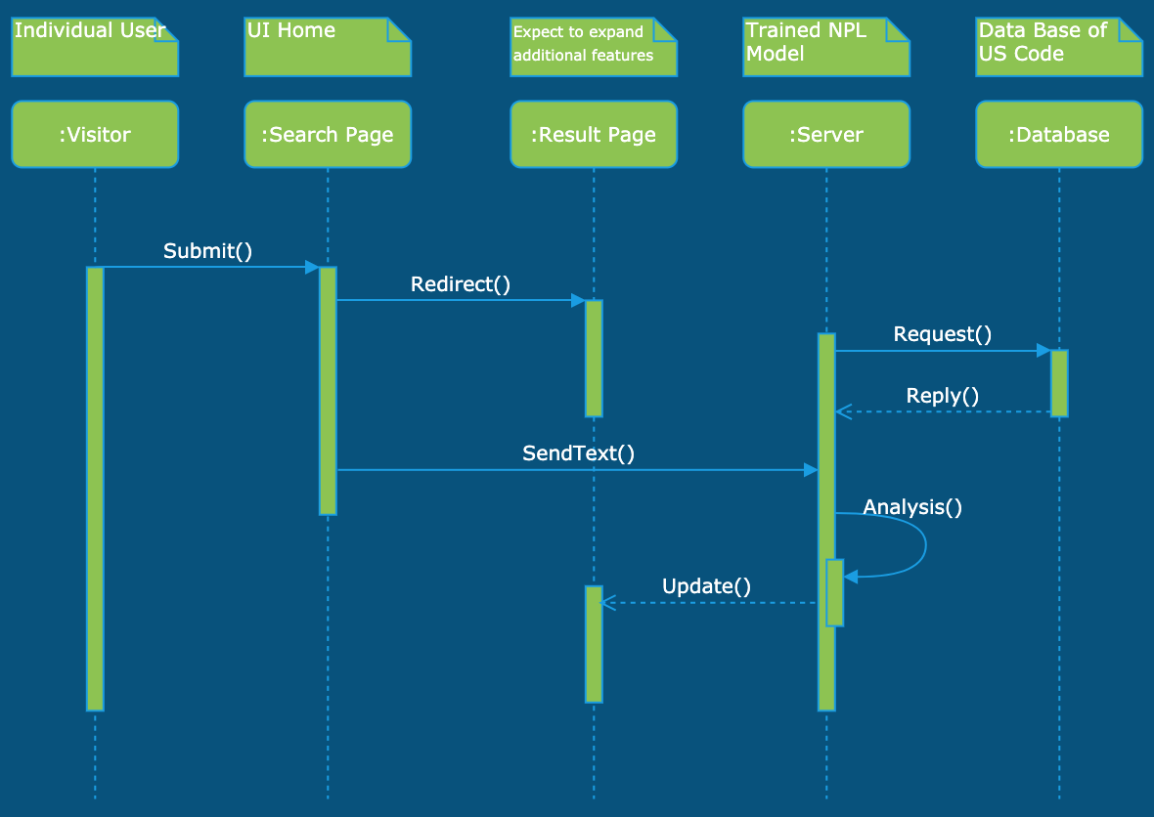
Project Design
This web-app does text analysis with a trained NLP model in the server, the server then requests appropriate law from database and provide legal advice to the customer.

Slide 4
Project Status as of March 10th
Most of our progress was made after March 10th. We attempted different models for NLP training and encountered challenges including data extraction from the caselaw api. The web-app development had to halt to accompany and assist NLP model training. Therefore the project fell a little behind the plan before March 10th.

Slide 5
Current Stage
Currently we are still at phase II of the project plan. Following the coronavirus outbreak, we planned to do a basic presentation with only a front-end UI since we will no longer have access to nvidia graphic cards at school after break. We are planning to use AWS for web hosting and future AI training.
As of right now, we see a more clear path to a working prototype. However, with the covid-19 situation, we are unsure what is going to happen with the Capstone project in general.

Slide 6
Challenges (covid-19)
Due to the coronavirus, we are not allowed to meet with advisors in person.
We have to delay key aspects of AI training.
We may not have the chance to find a more reliable model.
Plans on expanding the project in stage III may not take place.
Uncertainties with how the Capstone course will develop in the next 15 days

Slide 7
Revised Project Scope of Work
Next Step: We will be content with whatever we have now and move forward.
Post March 20th:
Stage I (originally before Mar. 23, moved to April 5th)
Complete and host webapp interface
Finish training NLP model
Stage II (originally before April 1st, moved to April 10th)
Complete merge of front and back end of the webapp
Make project video
Final Stage (Until report due)
Analyze and develop future improvement to be made to the system

Slide 8
Something Else to Add
Stay healthy

